Slide 1
Lecture 10 Synchronization Issues
Operating Systems
Notes:
Give qualifications of instructors:
DAP
teaching computer architecture at Berkeley since 1977
Co-athor of textbook used in class
Best known for being one of pioneers of RISC
currently author of article on future of microprocessors in SciAm Sept 1995
RY
took 152 as student, TAed 152,instructor in 152
undergrad and grad work at Berkeley
joined NextGen to design fact 80x86 microprocessors
one of architects of UltraSPARC fastest SPARC mper shipping this Fall

Slide 2
IPC issues
1. How do the processes communicate?
2. One process should not get into the way of another process when doing critical activities
3. Proper sequence of execution when dependencies are present
A produces data, B prints it
Before printing B should wait while A is producing data
B is dependent on A

Slide 3
Multithreading issues
All the 3 mentioned issues apply to multiple threads as well
1. How do the threads communicate
Simpler due to shared address space
2. One thread should not get into the way of another thread when doing critical activities
3. proper sequencing when dependencies are present
A produces data, B prints it
Before printing B should wait while A is producing data
B is dependent on A

Slide 4
IPC issues Vs Multithreading issues
Same solutions exists
The only difference could be the level at which the solution is applied
Kernel level
User level
From now on threads and processes both mean the same i.e. “Execution path”, unless otherwise specified

Slide 5
Common Storage
Multiple processes may be sharing a common storage
Read, Write, Update, Delete, Insert, etc
Common Main memory
Or Common File
Or Common xyz
The nature of the common storage does not change the nature of the problem
“Common storage” is an abstract concept
Implementation may differ

Slide 6
Race Condition: Example Print Spooler
If a process wishes to print a file it adds its name in a Spooler Directory
The Printer process
Periodically checks the spooler directory
Prints a file
Removes its name from the directory

Slide 7
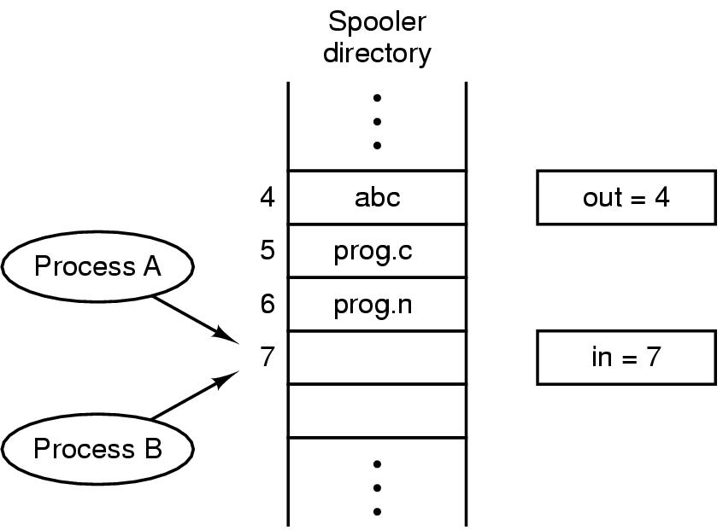
Example Print Spooler
If any process wants to print a file it will execute the following code
Read the value of in in a local variable next_free_slot
Store the name of its file in the next_free_slot
Increment next_free_slot
Store back in in
Next file to be printed
Shared
Variables
Next free slot in the directory

Slide 8
Example Print Spooler
Let A and B be processes who want to print their files
Process B will never receive any output
Process A
Process B
1. Read the value of in in a local variable next_free_slot
1. Read the value of in in a local variable next_free_slot
2. Store the name of its file in the next_free_slot
2. Store the name of its file in the next_free_slot
3. Increment next_free_slot
4. Store back in in
3 .Increment next_free_slot
4. Store back in in
Time out
A.cpp
B.cpp
next_free_slot_{a} = 7
next_free_slot_{b} = 7
in = 8
in = 7

Slide 9
Race Condition
Data is shared
The final result depends on which process runs first
Debugging is not easy
Most test runs will run fine

Slide 10
Other examples of Race conditions
Adding node to a shared linked list
first
5
9
17
22
26
34
Shared
Variables

Slide 11
Reason behind Race Condition
Process B started using one of the shared variables before process A was finished with it.
At any given time a Process is either
Doing internal computation => no race conditions
Or accessing shared data that can lead to race conditions
Part of the program where the shared memory is accessed is called Critical Region
Races can be avoided
If no two processes are in the critical region at the same time.

Slide 12
Critical Section
void threadRoutine()
{
int y, x, z;
y = 3 + 5x;
y = Global_Var;
y = y + 1;
Global_Var = y;
…
…
}

Slide 13
Critical Section
A enters critical section
A leaves critical section
Process A
B enters critical section
B blocked
Process B
T₁
T₂
T₃
T₄
B attempts to enter
critical section
B leaves
critical section
Mutual Exclusion
At any given time, only one process is in the critical section

Slide 14
Critical Section
Avoid race conditions by not allowing two processes to be in their critical sections at the same time
We need a mechanism of mutual exclusion
Some way of ensuring that one processes, whilst using the shared variable, does not allow another process to access that variable

Slide 15
Critical Section
In fact we need four conditions to hold.
No two processes may be simultaneously inside their critical sections
No assumptions may be made about the speed or the number of processors
No process running outside its critical section may block other processes
No process should have to wait forever to enter its critical section
It is difficult to devise a method that meets all these conditions.

Slide 16
Implementing Mutual Exclusion
Disabling Interrupts
Lock Variables
Strict Alternation

Slide 17
Disabling Interrupts
The problem occurred because the CPU switched to another process due to clock interrupt
Remember the CPU cycle
No Interrupt Checking
No Context Switching
Fetch Next
Instruction
Decode Instruction
Execute Instruction
Check for Interrupt:
Process Interrupt
Start
Halt

Slide 18
Disabling Interrupts
Solution: A Process
Disable interrupts before it enters its critical section
Enable interrupts after it leaves its critical section
CPU will be unable to switch a process while it is in its critical section
Guarantees that the process can use the shared variable without another process accessing it
Disadvantage:
Unwise to give user processes this much power
The computer will not be able to service useful interrupts
The process may never enable interrupts, thus (effectively) crashing the system
However, the kernel itself can disable the interrupts

